Slide 1
PAC分析の理論と具体的な実施技術 内藤哲雄（福島学院大学） いとうたけひこ（和光大学） 日本心理学会第79回大会 チュートリアルワークショップ 名古屋国際会議場 4階 第７会場/ レセプションホール第1室 2015年9月23日（2日目） １１：４０－１２：５０

Slide 2
PAC分析の特徴と今後の課題
①カウンセリングなど実践への応用（
②行列の表示（反証可能性のため）
③カテゴリー表の明記（質的研究者との共有可能性）
④SPSSの出力の方法
⑤混合研究法（ミックス法）か質的研究か

Slide 3
PAC分析学会
ML（非会員もOKです。）：pac@wako.ac.jp
に参加してください。
→いとうたけひこ take@wako.ac.jp
まで申請してください。
●PAC分析学会大会
第9回大会を12月19日に日本女子大学目白キャンパスにて開催いたします。 演題及び発表抄録を募集いたします。 発表時間は口頭発表で40分を予定 締め切りは11月10日

Slide 4
①カウンセリングなど実践への応用
井上孝代 (1997). 留学生の文化受容態度とカウンセリング:PAC分析による事例研究を通して カウンセリング研究, 30, 216-226.
井上孝代 (1998). カウンセリングにおけるPAC(個人別態度構造)分析の効果 心理学研究, 69, 295-303.

Slide 5
②行列の表示（反証可能性のため）

Slide 6
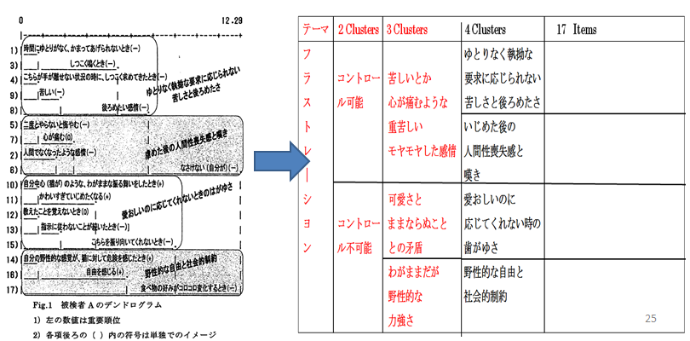
③カテゴリー表の明記 （質的研究者との共有可能性）

Slide 7
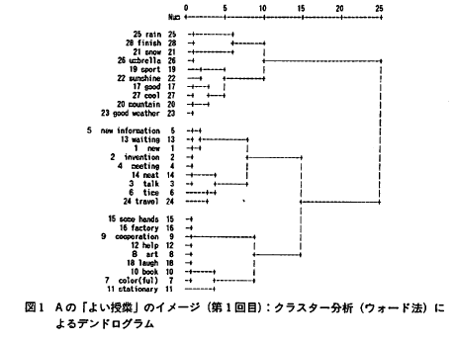
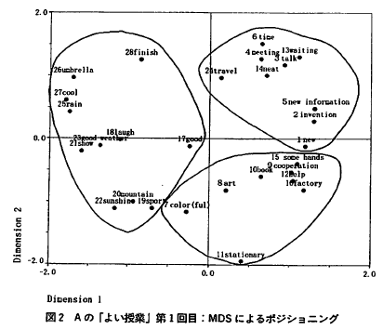
④SPSSの出力とMDSの図

Slide 8
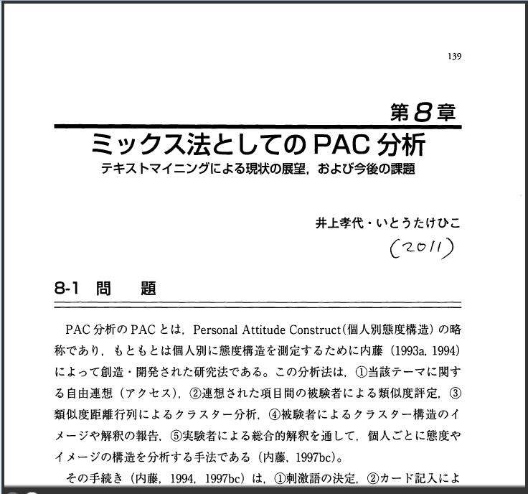
⑤PAC分析は混合研究法 （ミックス法）か質的研究か

Slide 9
Is PAC Analysis a mixed methods research? Takehiko Ito 1), Tetsuo Naito 2), Takayo Inoue 3), and Ikumi Ozawa 4) 1) Wako University, Japan, 2) Fukushima College, Japan, 3) Meiji Gakuin University, Japan, 4) International Christian University, Japan. Mixed Methods International Research Association (MMIRA) Asia Regional Conference in Japan The Inaugural Conference for Japan Society for Mixed Methods Research (JSMMR) September 19-20, 2015

Slide 10
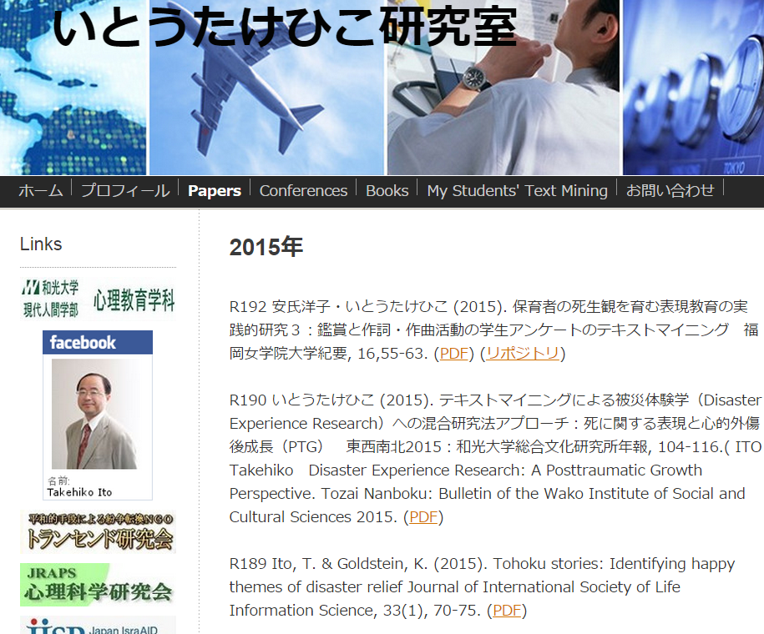
www.itotakehiko.com

Slide 11
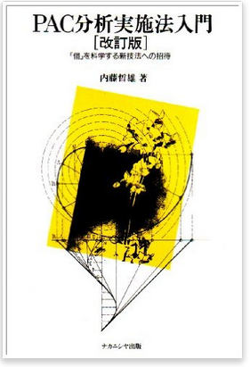
What is PAC Analysis?
Personal Attitude Construct (PAC) Analysis was proposed by Tetsuo Naito (1993, 1997)
as a method to seek the individual structure of attitude
using visualization (dendrogram) and a dialogical interview.

Slide 12
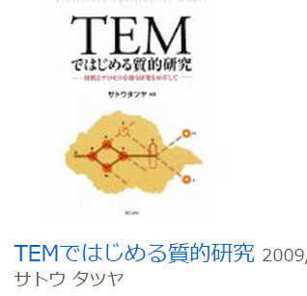
Two unique research methods made in Japan often referred as qualitative research methods
PAC Analysis
(個人別態度行動分析)
Trajectory Equfinality Approach
（複線径路等至性モデル）

Slide 13
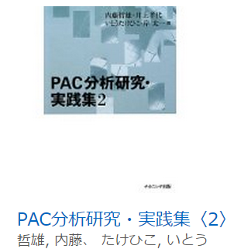
Is PAC Analysis a qualitative research or a mixed methods research?
Inoue and Ito (2011) argued that the PAC Analysis is one of multiplied mixed methods(乗算的ミックス法),
while the mixed methods research is usually referred to not multiplicative（かけ算的） but additive combination（足し算的） of qualitative and quantitative approaches.

Slide 14
Purpose of my presentation
The purpose of the present research is to characterize PAC Analysis from the perspective of mixed methods research.
PAC分析は質的研究か？ 混合研究法か？
QUAL？ or MMR ？

Slide 15
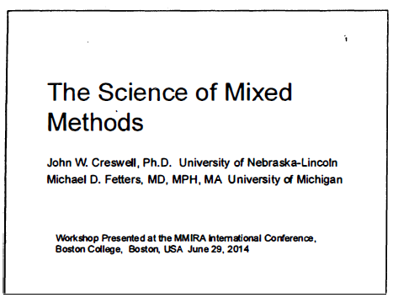
Creswell and Fetters’ Workshop at MMIRA Conference in Boston College, 2014

Slide 16
What I learned：３ types of basic MMR ①収斂型 ②順次説明型 ③順次探究型

Slide 17
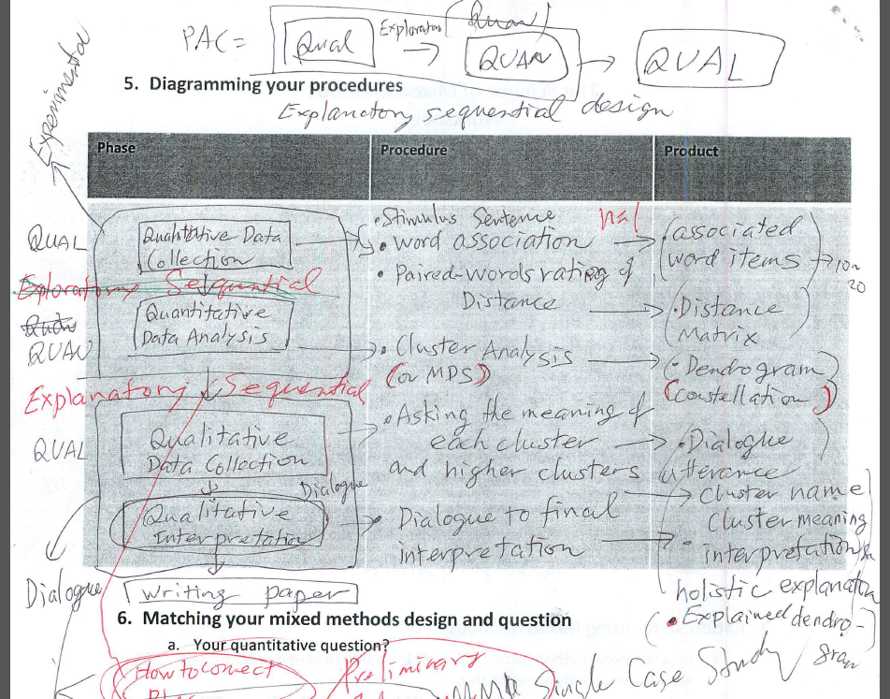
My worksheet (2014): Phase, Procedure, and Product of PAC Analysis

Slide 18
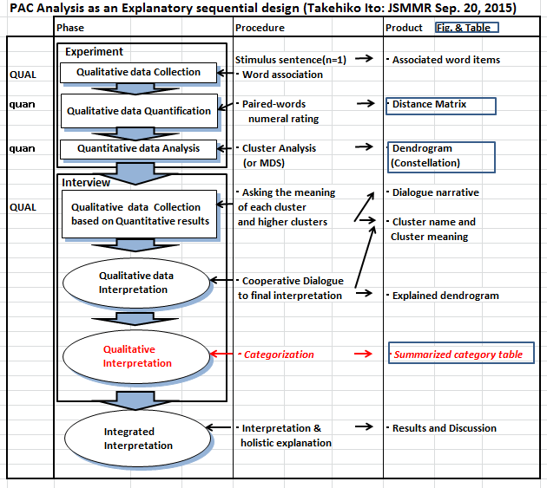
Today (I year and 3 month later)

Slide 19
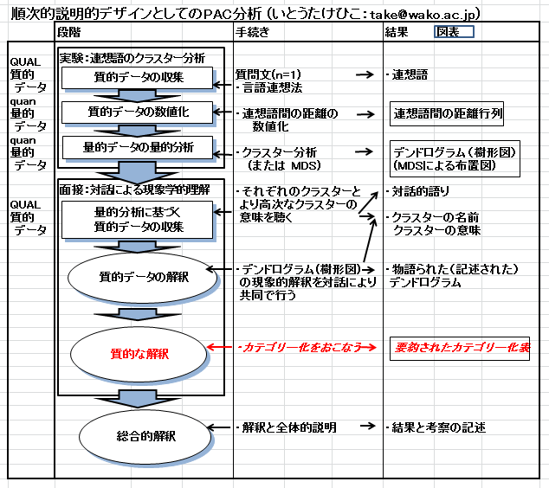
Japanese version

Slide 20
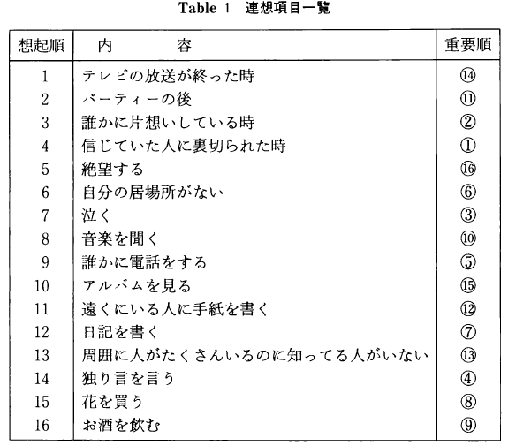
Phase ① QUAL （open-ended questions） Procedure: By stimulus sentence (n=1), Word association (語連想)produces Product: An associated word (or sentence) item list

Slide 21
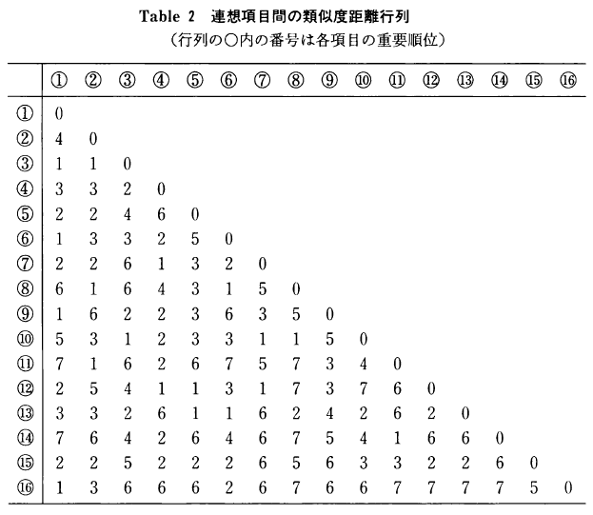
Phase ② quan (closed-ended questions) Procedure: Paired-words rating of distance Product: Distance Matrix

Slide 22
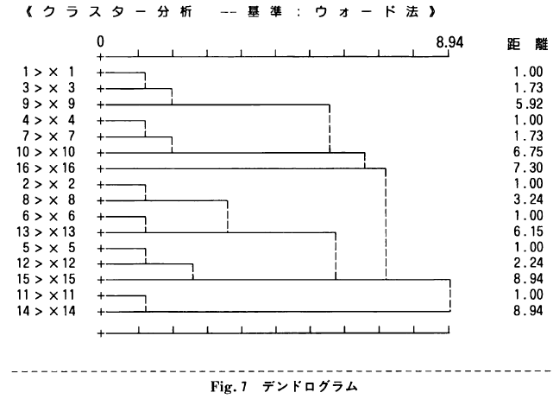
Phase ③ quan (multivariate analysis) Procedure: Cluster Analysis by Ward Method Product: Dendrogram (樹形図)

Slide 23
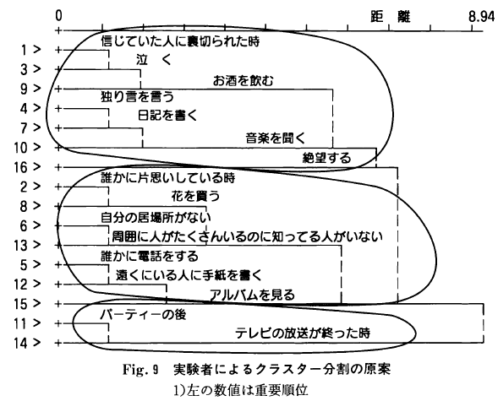
Phase ④ quan → QUAL (open-ended questions) Procedure: Ask the meaning of each and higher clusters Product: Dialogue narrative & cluster name (=meaning)

Slide 24
Phase ⑤: Interpretation(open-ended questions) Procedure: Cooperative dialogue to final interpretation Product: cluster name (=meaning) & fully explained dendrogram

Slide 25
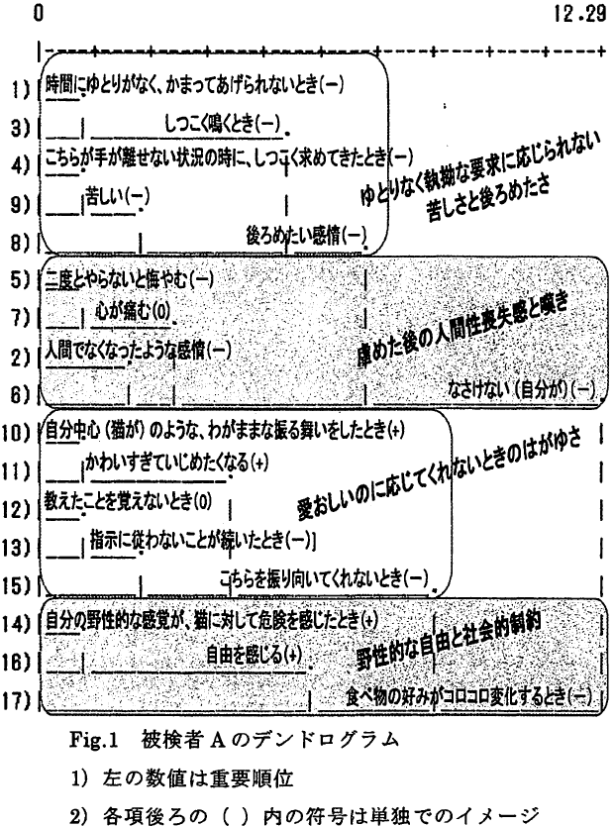
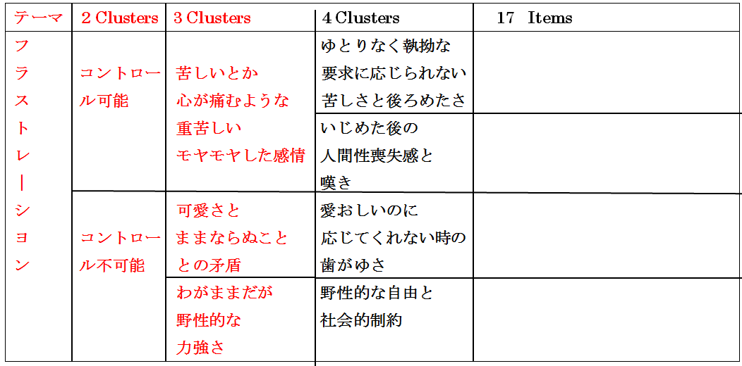
Phase ⑥ (for dialogue with non-PACA users) Procedure: Categorization of clusters Product: Summarized Category Table 内海裕里花・内藤哲雄・七海隆之（2014）コンパニオンアニマルへのフラストレーションと攻撃行動：飼い猫を対象としてのPAC分析 PAC分析学会第8回大会プログラム・発表抄録集, 17-21.

Slide 26
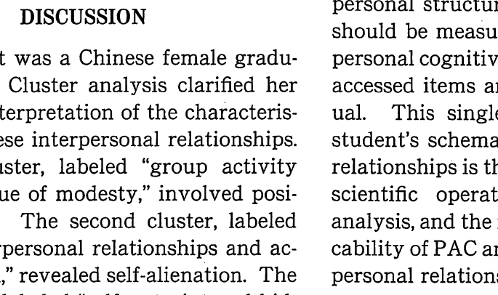
Phase ⑦: Interpretation Procedure: Integrated holistic explanation Product: Discussion & Conclusion

Slide 27
Discussion:
According to the characteristics of its procedures, PAC Analysis can be identified as a mixed methods research by sequentially combining QUAL and QUAN data collection and analysis.
PAC Analysis as Explanatory sequential design
( or is it Exploratory sequential design?)
( or a qualitative approach with visualization?)

Slide 28
Discussion (2)
PAC Analysis method is a powerful approach as a research and counseling tool (Inoue, 1997, 1998).
Its advantages are:
(1) visualizing an individual’s inner world,
(2) analyzing shared words and their meanings based on narrative, and
(3) conducting an evidence-based case study.

Slide 29
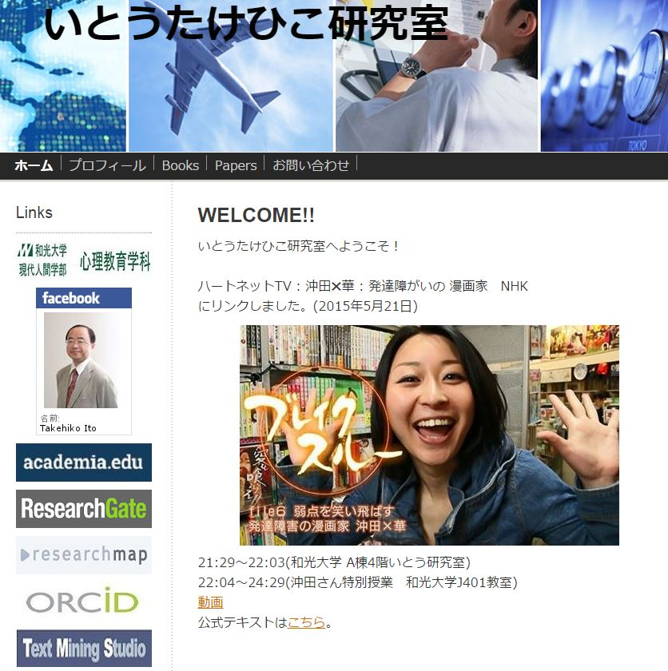
Thank you. Comments are welcome

Slide 30
付録１：質的研究法としてのPAC分析 as a Semi-Automatic Thematic Analysis
Thematic Analysis (Boyatzis, 1998): = A process to be used with qualitative information. It is not a another qualitative method but a process that can be used with most, if not all qualitative methods (methods of data collection).
Thematic analysis is a process for encoding qualitative information.
‘A research method for the subjective interpretation of the content of text data through the systematic classification process of coding and identifying themes or patterns’ (Hsieh & Shannon, 2005)
PAC Analysis =Thematic Analysis + Relational Analysis (Ito, 2014)

Slide 31
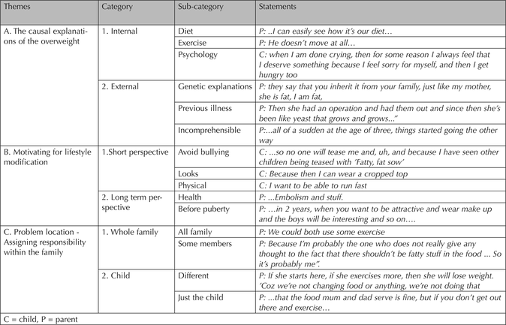
付録２：Thematic Analysisの結果の表示例 Bicquelet(2014)の資料より

